Slide 1

E-COMMERCE INSIGHTS: DRIVING BUSINESS STRATEGIES WITH SQL
By Dickna Nenden Woro Ramadityawati

Slide 2
Project Overview
The project leverages SQL queries to explore e-commerce transaction data from 2021 and 2022. The goal is to uncover valuable insights that can guide future business strategies in areas such as product performance, transaction analysis, and customer behavior.
Background:
In the fast-paced e-commerce industry, data is key to staying competitive. Businesses collect vast amounts of transactional data, but without proper analysis, critical insights are missed. This project addresses that gap, turning raw data into actionable business intelligence. This can enable more informed decisions, strategic planning, and ultimately, growth.
Goals:
Identify peak transaction periods and high-performing categories.
Compare year-over-year performance to spot growth opportunities and areas of decline.
Analyze customer payment preferences to improve checkout experience.
Rank top-selling products to guide marketing and inventory decisions.
What if the data reveals unexpected trends that could reshape the company’s strategy? Let’s dive in to find out.

Slide 3
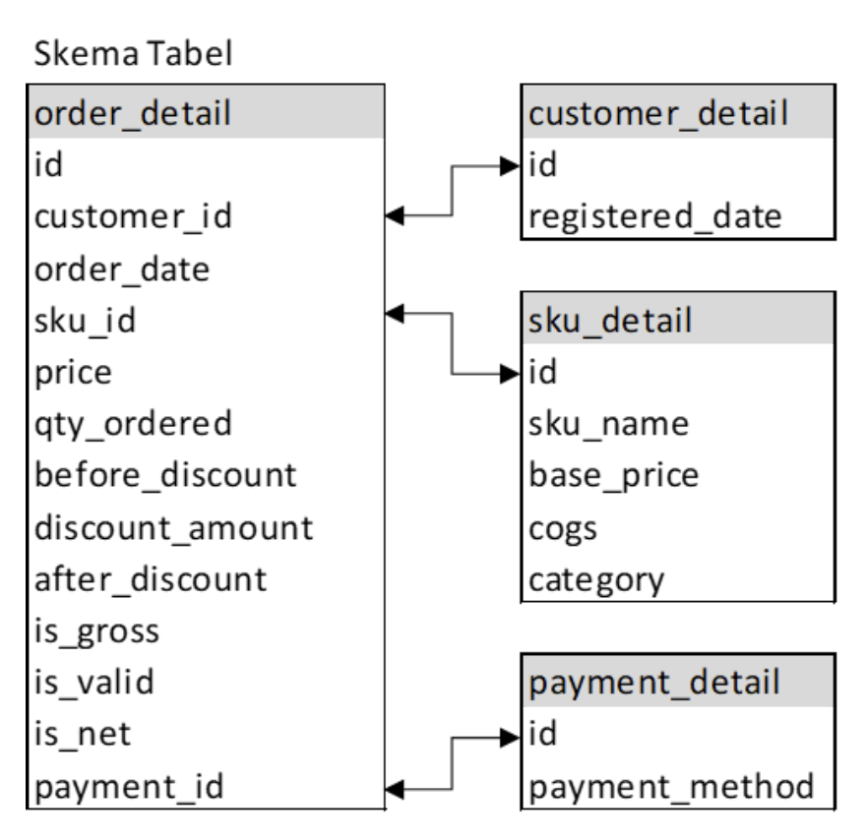
Dataset
The dataset used in this project from Tokopedia (simulated data) and comprises a rich collection of interconnected transactional and customer data, enabling comprehensive analysis through relationships between tables. It consists of four key tables:
order_detail: contain order data such as order date, product ID, price, and discount information
sku_detail: Hold product information, such as product name and product category.
customer_detail: customer-related information, registration date.
payment_detail: Data about payment methods used for transactions.

Slide 4

Business Strategies
Analysis & Insight

Slide 5
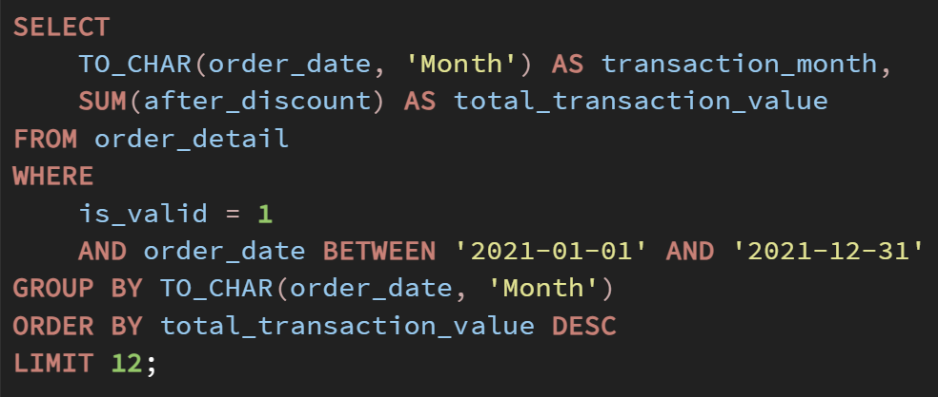
Identifying Peak Transaction Month in 2021
To optimize marketing strategies and resource allocation, the company aims to identify the month with the highest total transaction value in 2021. This analysis will help determine the seasonal trends in customer spending.
Approach:
We filtered the data to include only valid transactions (is_valid = 1) within the date range of January 1, 2021, to December 31, 2021. The total transaction values after discounts were aggregated by month using the SQL function TO_CHAR to extract the month from the order_date. The results were then sorted in descending order to identify the month with the highest transaction value.

Slide 6
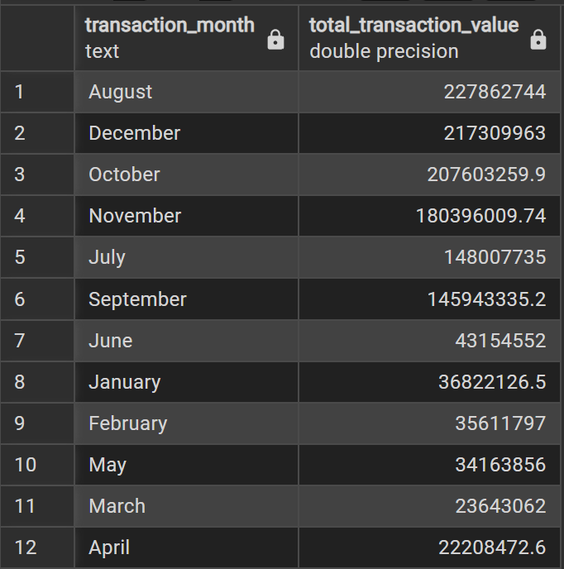
Identifying Peak Transaction Month in 2021
Insight:
The highest transaction value occurred in August with 227,862,744 (17.2% of the annual total), followed by December at 217,309,963 (16.4%) and October at 207,603,259.9 (15.7%). Together, these three months contributed 49.3% of the total transactions. July and September also performed well with around 11% each, while January, February, and March had the lowest contributions, totaling under 7%.
Recommendation:
Leverage August's Peak: Targeted promotions, discounts, or loyalty programs can maximize revenue.
Plan for the Holiday Season: Allocate resources for December marketing and inventory based on its strong performance.
Replicate October's Success: Investigate factors behind October's high value and replicate successful strategies.
Boost Early-Year Sales: Implement Q1 promotions to stimulate spending during slower months.
August's peak may result from seasonal promotions or back-to-school sales, December's spike aligns with holiday spending, and October's strong results may be tied to pre-holiday campaigns.
What factors drove the August surge, and how can the company replicate this success throughout the year?

Slide 7
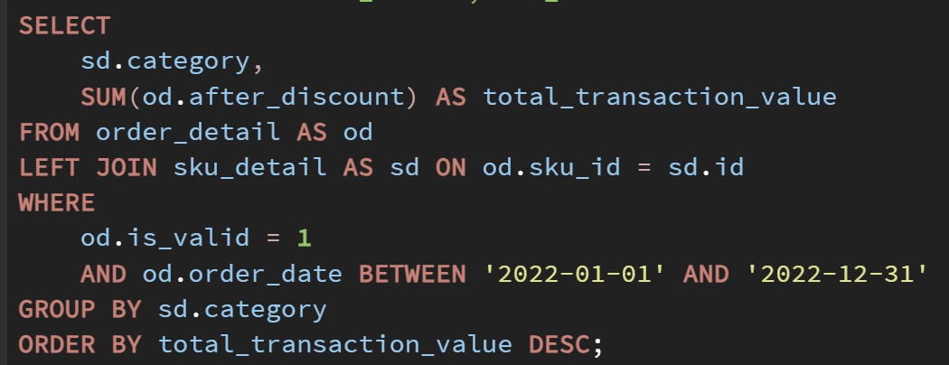
Identifying Top-Performing Category in 2022
In order to optimize product strategies and allocate marketing resources effectively, the company aims to identify which product category generated the highest transaction value in 2022. Understanding the top-performing categories will help the company focus on high-value products and tailor future campaigns to boost sales in underperforming categories.
Approach:
We filtered the data for valid transactions (is_valid = 1) between January 1 and December 31, 2022. By joining the order_detail and sku_detail tables, we aggregated the total transaction value after discounts for each product category. The results were sorted to identify the category with the highest total transaction value.

Slide 8
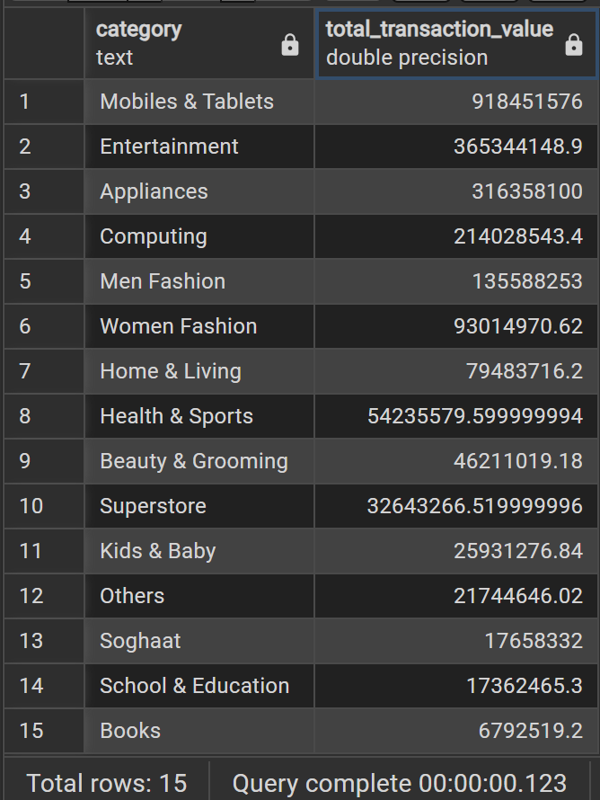
Identifying Top-Performing Category in 2022
Insight:
The "Mobiles & Tablets" category led with a total transaction value of 918,451,576, contributing 39.1% of the total transaction value across all categories. The "Entertainment" category followed with 365,344,148.9, accounting for 15.3%, and "Appliances" with 316,358,100, contributing 13.1%. These three categories together made up 67.5% of the total transaction value. Categories like "Books" (0.3%) and "Soghaat" (0.2%) showed the least performance, representing a very small portion of the total sales.
Recommendation:
Maximize Mobiles & Tablets: Invest in promotions, discounts, or exclusive deals for this category to further increase sales and capitalize on its dominance.
Boost Underperforming Categories: Run promotions or bundle offers for low-performing categories like Books and Soghaat to attract more attention and sales.
Strengthen Appliances & Computing Marketing: Continue to promote Appliances and Computing by identifying successful strategies in top months and replicating them.
What strategies can be implemented to further elevate the performance of the "Mobiles & Tablets" category, and can similar tactics be applied to other high-performing categories?

Slide 9
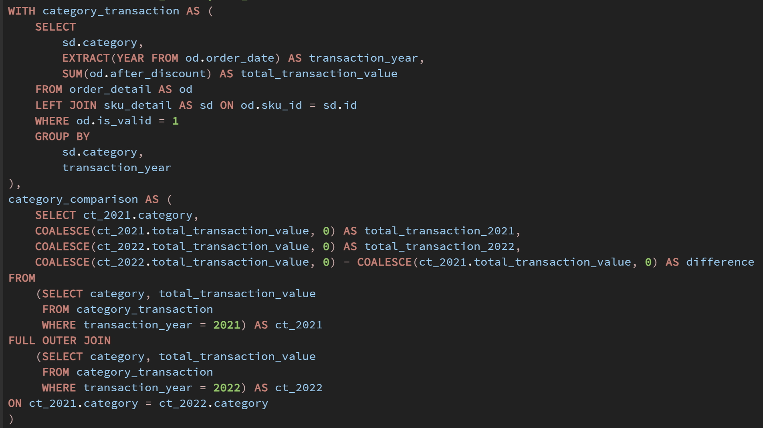
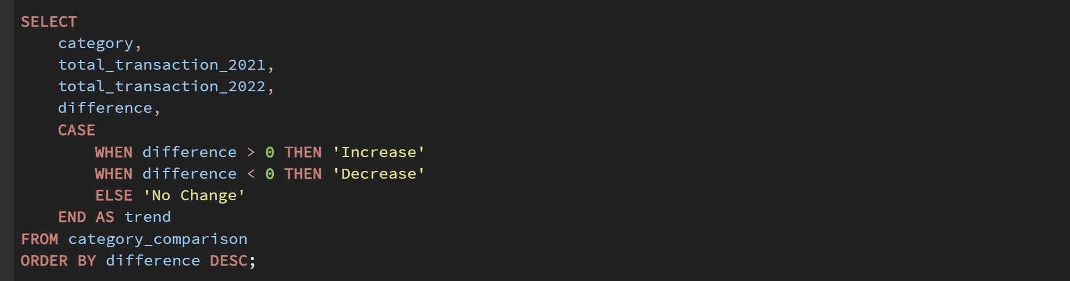
Comparing Transaction Values by Categories (2021 vs 2022)
To evaluate the effectiveness of marketing and sales strategies, the company aims to compare transaction values across product categories in 2021 and 2022. This comparison will help identify categories that experienced growth and those that saw a decline, providing insights for optimizing future business strategies.
Approach:
We filtered the data for valid transactions (is_valid = 1) from both 2021 and 2022. By aggregating the total transaction values for each category by year, we performed a full outer join to compare transaction values across the two years. The difference in values was calculated to identify categories with growth, decline, or no change.

Slide 10
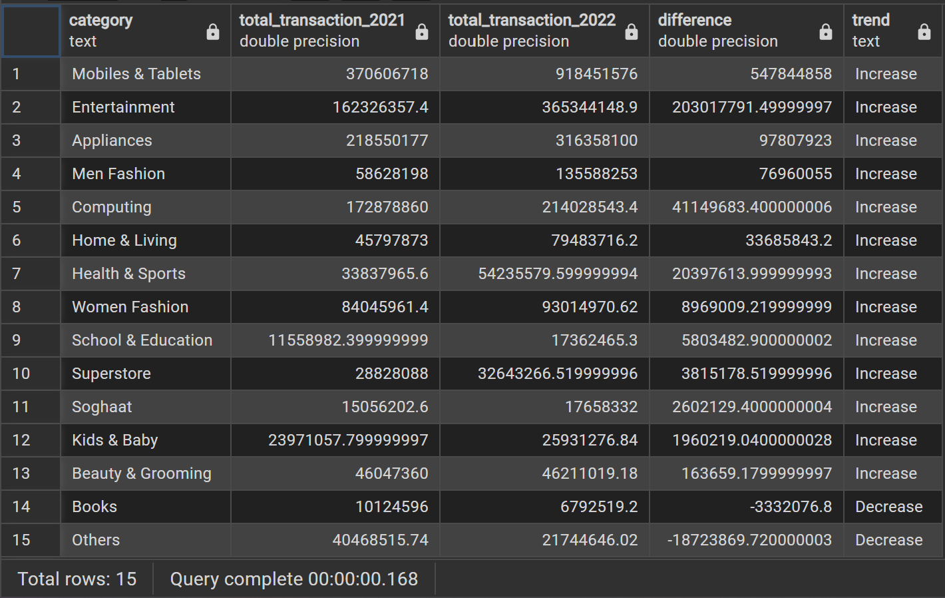
Comparing Transaction Values by Categories (2021 vs 2022)
Recommendation:
Maximize Growth in Top Categories: Invest in "Mobiles & Tablets" and "Entertainment" through exclusive deals, product bundling, and influencer marketing.
Revitalize Declining Segments: Offer discounts, digital alternatives, or curated collections for "Books" and "Others" to reignite demand.
Monitor Market Shifts: Conduct customer surveys to understand category preferences and adjust strategies accordingly.
The significant growth in "Mobiles & Tablets" and "Entertainment" can be attributed to continued demand for electronics and digital media, which likely benefited from technological advancements and increased consumer interest. On the other hand, the decline in "Books" and "Others" could reflect shifting consumer preferences, such as moving away from traditional media in favor of digital content or changes in market saturation.
Insight:
Most categories experienced growth, with "Mobiles & Tablets" leading at +547.8M (+147.8%), increasing from 370.6M to 918.4M. "Entertainment" grew by +203M (+125.1%), followed by "Appliances" (+97.8M, +44.8%). Other notable increases include "Men Fashion" (+31.5%), "Computing" (+23.8%), and "Home & Living" (+73.6%).
However, "Books" saw a -3.3M drop (-32.9%), and "Others" declined by -18.7M (-46.3%), indicating reduced consumer interest.
What can the company do to reverse the decline in categories like Books and Others, and how can it sustain the growth in high-performing categories?

Slide 11
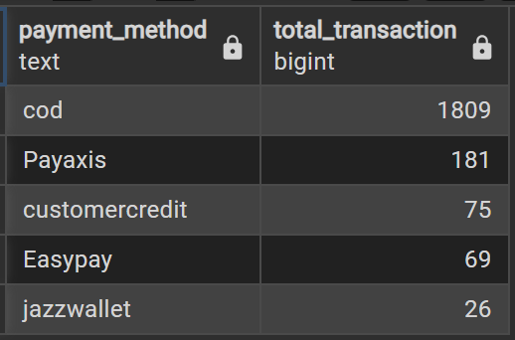
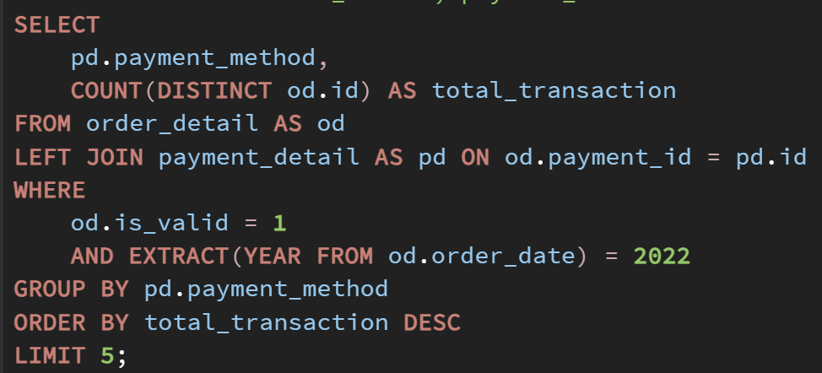
Top 5 Most Popular Payment Methods in 2022
To enhance the customer checkout experience and optimize payment processing, the company seeks to identify the most frequently used payment methods in 2022. Understanding user preferences will help refine payment options, streamline transactions, and improve conversion rates.
Insight:
Cash on Delivery (COD) dominated as the most preferred payment method, highlighting customer trust in post-payment transactions. Payaxis showing moderate adoption. Customer Credit and Easypay had lower but notable usage. JazzWallet had the least adoption among the top five, indicating limited customer reliance on digital wallets.
Approach:
We filtered valid transactions (is_valid = 1) for 2022 and counted unique orders per payment method. The top five methods were ranked based on the number of distinct transactions.
Recommendation:
Enhance Trust in Online Payments: Improve payment security messaging, provide seamless refund policies, and offer customer support for digital transactions.
Expand Digital Payment Options: Partner with additional providers to increase accessibility and convenience.
Optimize COD Processes: Streamline COD logistics to maintain efficiency while gradually transitioning users toward digital alternatives.
How can the company further encourage digital payment adoption while maintaining a seamless customer experience?
The overwhelming reliance on COD suggests trust issues with digital payments, customer convenience preferences, or limited access to online banking. The relatively low usage of digital payment methods indicates an opportunity to promote and incentivize non-cash alternatives.

Slide 12

Brand Transaction Analysis
Understanding the transaction value distribution among major tech brands such as Samsung, Apple, Sony, Huawei, and Lenovo is essential for identifying market trends and optimizing sales strategies. The challenge lies in accurately categorizing products under their respective brands and calculating their financial impact. By utilizing a CASE WHEN statement, we can systematically classify products, ensuring precise brand identification and a more effective analysis of their transaction values.
Approach:
To address this challenge, the analysis follows these steps:
Identifying product distribution by category to understand where each brand has a significant presence.
Filtering and mapping product names to ensure correct brand classification.
Calculating transaction values for each brand to determine their market impact.
Deriving insights and forming strategic recommendations based on the findings.
By following this approach, we minimize data misclassification and ensure meaningful interpretations that support decision-making.

Slide 13
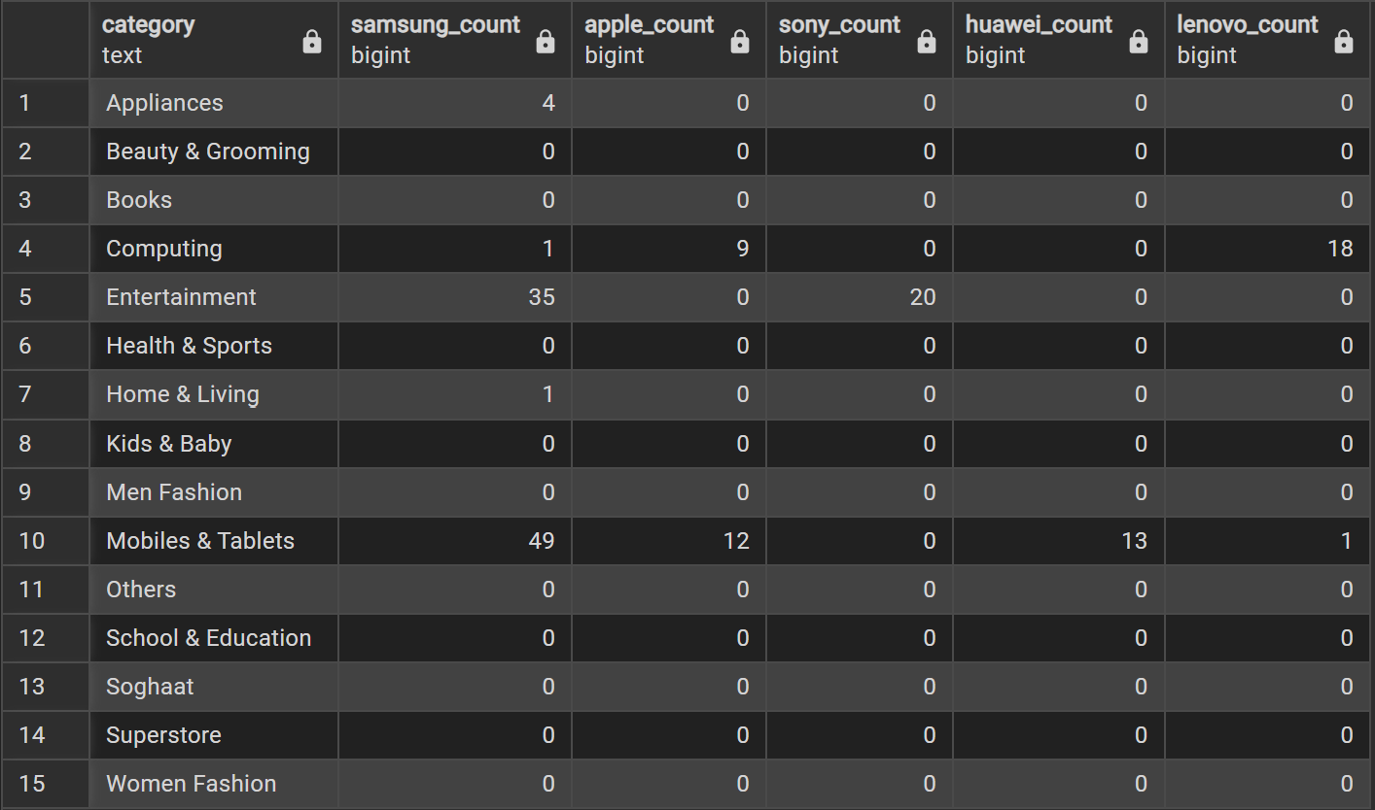
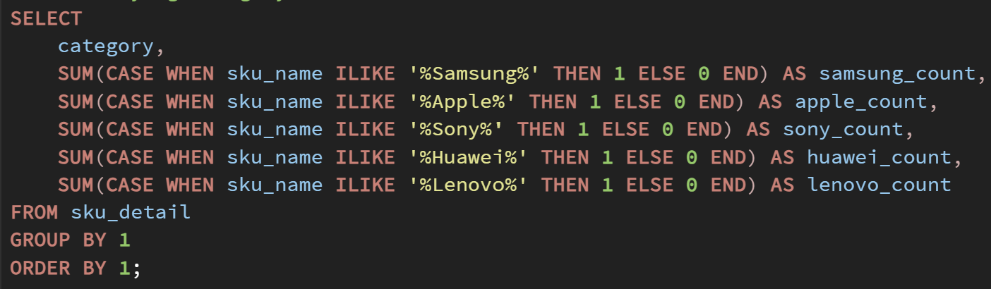
Step 1: Identifying Brand Presence Across Categories
Approach:
The first step involves determining which product categories contain items from Samsung, Apple, Sony, Huawei, and Lenovo. This ensures that only relevant products contribute to the brand analysis.
Analysis revealed that these brands are primarily fall under the categories of ‘Appliances’, ‘Computing’, ‘Entertainment’, ‘Home & Living’, and ‘Mobiles & Tablets’.

Slide 14
Step 2: Identifying Key Products
Category | Samsung | Apple | Sony | Huawei | Lenovo
Appliances | √
Computing | √ | √ |  |  | √
Entertainment | √ |  | √
Home & Living | √
Mobiles & Tablets | √ | √ |  | √ | √
Approach:
After determining category-level distribution, the next step is to ensure precise brand-product mapping. This involves identifying specific product names commonly associated with each brand to prevent misclassification.
Brand-Specific Product Mapping:
Samsung: Galaxy, Note, Tab
Apple: iPhone, iPad, MacBook, iMac, HomePod, Mac Mini
Sony: PlayStation, PS4
Huawei: MatePad, P-Series, Nova
Lenovo: ThinkPad, Zuk Series
This step refines the analysis by ensuring only relevant products contribute to a brand’s total transaction value. It eliminates ambiguity in cases where products might have similar names across brands, ensuring that transaction calculations are brand-specific and accurate.

Slide 15
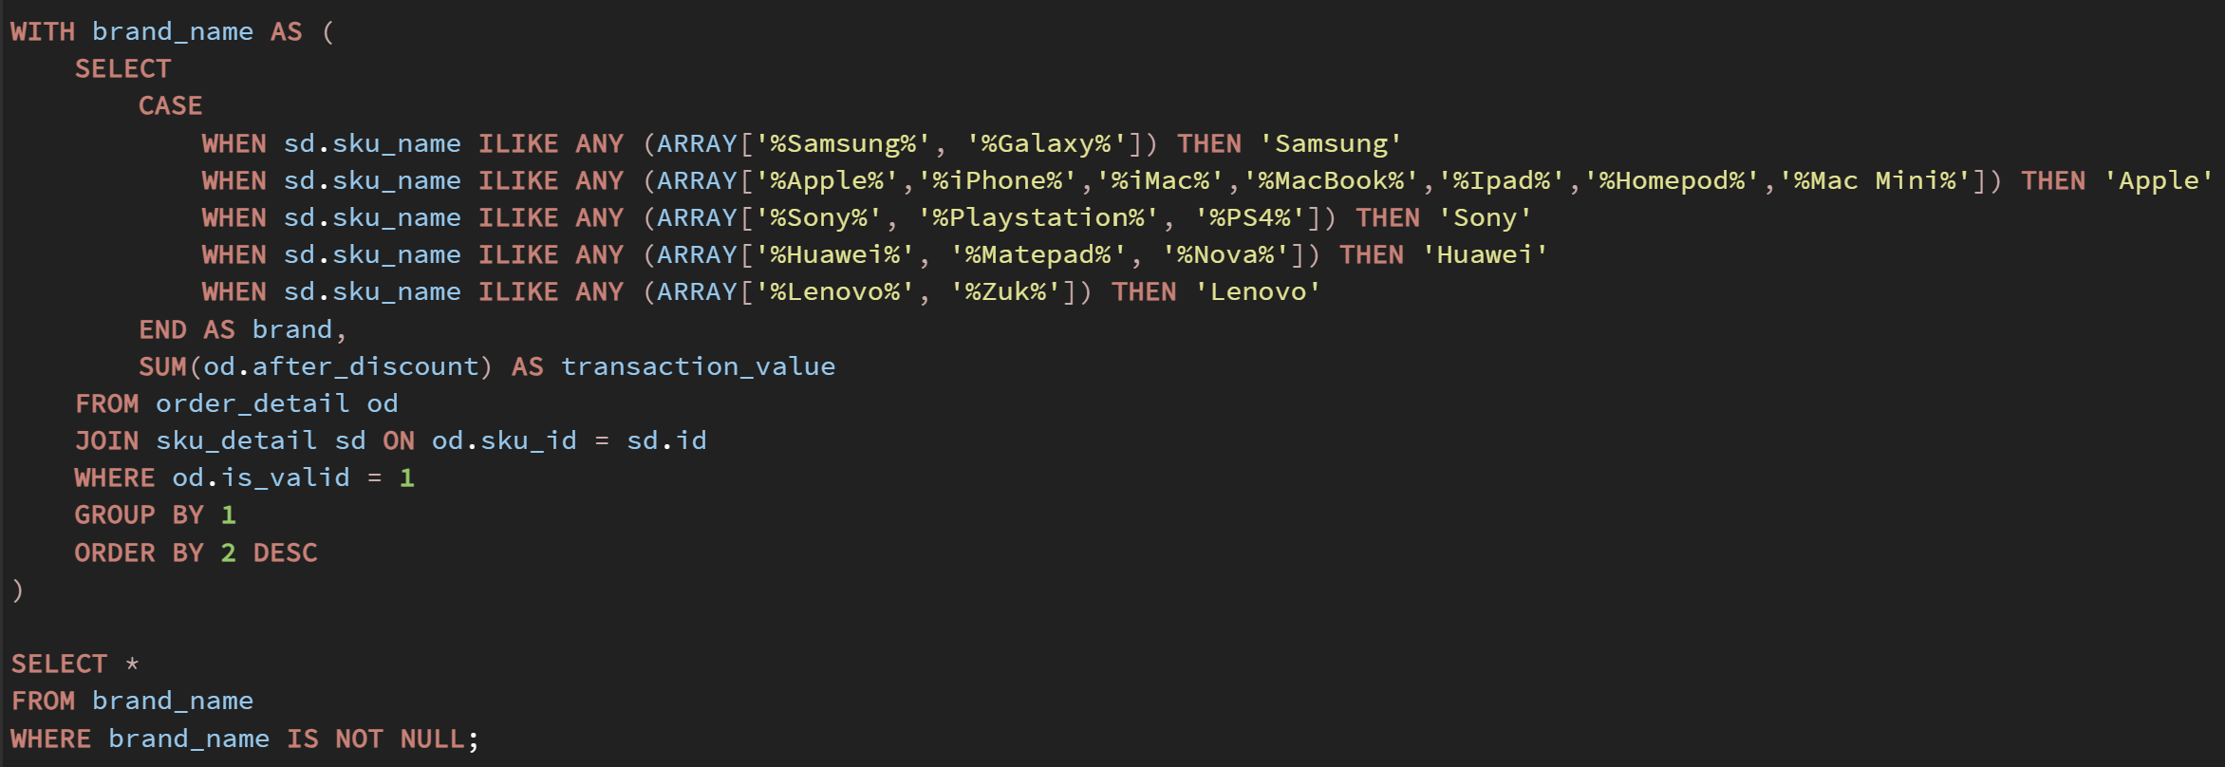
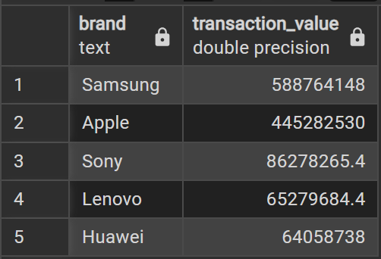
Step 3: Calculating Transaction Values for Each Brand
Approach:
To determine each brand's total transaction value, we apply a CASE WHEN statement to group products and calculate their total after_discount transaction values.
Future strategies should focus on reinforcing Samsung and Apple’s dominance while exploring opportunities to boost the performance of Sony, Huawei, and Lenovo. Analyzing category-level performance within each brand can provide deeper insights into specific best-selling products.
Insight:
Samsung leads the market with Rp588,764,148 in transaction value, followed by Apple, Sony, Lenovo, and Huawei.
Recommendation:
Enhance Market Penetration – Strengthen brand presence through targeted marketing campaigns and competitive pricing strategies.
Optimize Product Positioning – Focus on high-performing categories and refine offerings based on consumer demand.
Improve Sales & Distribution Channels – Expand e-commerce partnerships, streamline logistics, and enhance in-store experiences.

Slide 16
Conclusion
This project demonstrates the effective utilization of SQL for data-driven analysis, enabling businesses to make informed strategic decisions. By analyzing transaction trends, category performance, and brand contributions, we provide actionable insights to enhance business operations.
Enhancing Product Category Focus:
Since Mobiles & Tablets contribute the highest revenue, companies should prioritize inventory planning, promotional efforts, and customer engagement in these high-performing segments to drive sales growth.
Payment Preference Insights:
Our findings indicate that Cash on Delivery (COD) remains a dominant payment method, suggesting opportunities to encourage digital payment adoption through incentives and promotions.
Strategic Revenue Allocation:
Understanding the financial contribution of each brand allows for better pricing strategies, competitive positioning, and resource distribution, ensuring sustainable revenue growth.
Optimizing Brand Market Positioning:
With Samsung and Apple leading in transaction value, businesses can leverage their dominance by forming stronger partnerships, exclusive deals, and targeted marketing campaigns to maximize profitability.

Slide 17

Thanks!
Do you have any questions?
For further questions or discussions, feel free to reach out:
Let’s collaborate to drive better insights!

